Slide 1
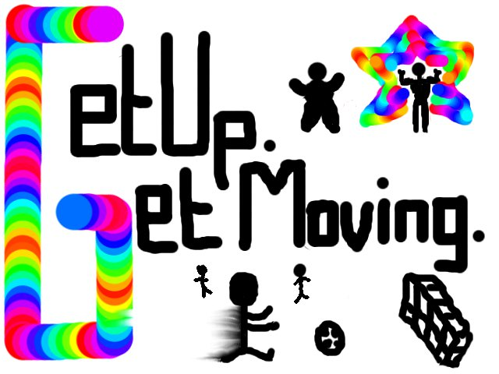
Get Up, Get Moving! Quiz

Slide 2

Welcome to the quiz
  These 10 Question Contain Different Information to test your knowledge about Fitness and Health ”
  It also Provides Extended Tips and Information “
  Instructions: This is like any ordinary quiz, there are 10 questions to answer, you just have to click on which answer you think is right ,if you get it wrong you always have a chance of redeeming yourself by trying again; so everyone wins at the end.
  These Symbols will help you get back and forth on the quiz
This will help you to get onto the extra information from the question you have just answered(optional)
This is to help you return to a question or go onto an new question

Slide 3
1.What Does BMI stand For?
A. Body mass index
B. Body move index
C. Based movement index

Slide 4


Try Again
Sorry!, Try Again”

Slide 5


WELL DONE
“Correct !”
Want to know what BMI Actually is?

Slide 6
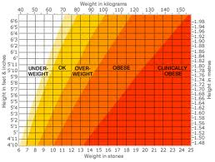
BMI
The Body Mass Index (or BMI) is a way of seeing if your weight is appropriate for your height. The actual calculation is your weight (in kilograms) divided by your height (in metres) squared but it's also easy to read on the chart. BMI can be divided into several categories and generally the higher your BMI, the greater your risk of a large range of medical problems.

Slide 7
2.What does Calorie Mean?”
A. The energy needed to raise the temperature of 1 gram of water through 1 °C (now usually defined as 4.1868 joules).
B. an index that expresses adult weight in relation to height. It is calculated as weight in kilograms divided by height in metres squared. A body mass index of less than 25 is considered normal, and one of over 30 implies obesity.
C. the quality of heaviness in things, determined by their mass or quantity of matter as acted on by the force of gravity, that counteracts efforts to lift or move them

Slide 8
WELL DONE
Correct !”
Learn More About Calories!

Slide 9
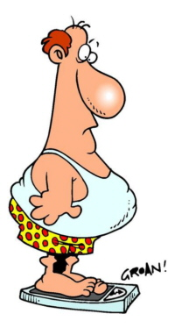
Calories
Calories are a measure of the amount of energy in food. Knowing how many calories are in our food can help us to balance the energy we put into our bodies with the energy we use. And that’s the key to a healthy weight. If you’re trying to lose weight, it’s a good idea to eat less and be more active. Eating less is important when you're trying to lose weight, even if you already have a balanced diet.

Slide 10
Try Again
Sorry, Wrong Answer!”

Slide 11
3.What country has the most obese people?
A. United Kingdom
B. India
C. America

Slide 12
WELL DONE
Correct !”
Why is This population so Obese?

Slide 13
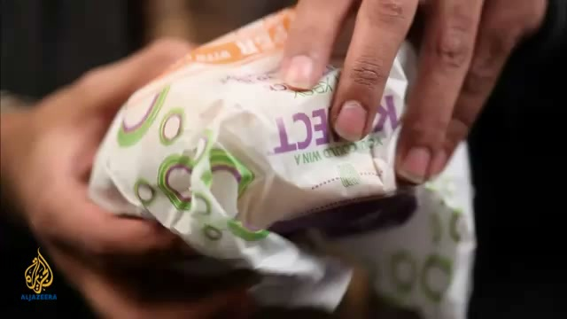
USA
Click on the picture , if you want to Watch Video

Slide 14

Try Again
Sorry, Wrong Answer!”

Slide 15
4. Why is it so important for teenage girls to get enough iron?
A. Iron is The process of providing or obtaining the food necessary for health and growth.
B. It helps them with their co-ordination level
C. A lack of iron can make you feel tired, faint and breathless

Slide 16
WELL DONE
Correct!”
Teen Girls and Iron

Slide 17
5.What Exercise Will improve an Over 65’s balance and coordination?
A. Rugby
B. Tai Chi
C. Tennis

Slide 18
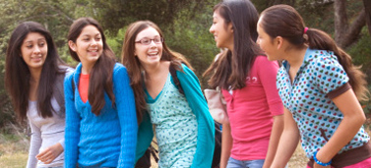
Teen girls and iron
Only 60% of teenage girls have the recommended amount of iron in their diet. A lack of iron can make you feel tired, faint and breathless. It can also make it difficult to concentrate, which makes studying and taking exams more difficult. But it’s easy to get more iron into your diet.

Slide 19
6.Can you still run with a muscle strain?
A.Yes,The pain goes in 1minute
B. It depends if your feeling up to it
C. No, It depends on if the injury is too severe

Slide 20
Try Again
Sorry, Wrong Answer!”

Slide 21
WELL DONE
Correct!”
Elderly Can Still do fun exercise

Slide 22
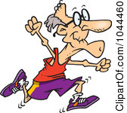
Elderly Exercise
Older adults aged 65 or older, who are generally fit and have no health conditions that limit their mobility, should try to be active daily and should do:
At least 150 minutes (2 hours and 30 minutes) of moderate-intensity aerobic activity such as cycling or fast walking every week
Older adults aged 65 or older, who have a disability or health problems can still join in the fun by doing yoga, aerobics and surprisingly Tai Chi!

Slide 23
Try Again
Sorry, Wrong Answer!”

Slide 24
WELL DONE
Correct!.”
Tips for preventing injury and Staying Motivated

Slide 25
Try Again
Sorry, Wrong Answer!”

Slide 26
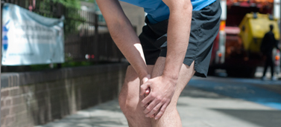
Tips!
Preventing Injury
Wear the right shoes
Warm up and cool down
Build Up Slowly
Staying Motivated
Being injured can be very frustrating. If you’re new to running, you might be tempted to give up at the first sign of injury.
Andy says that having a specific goal, such as a 5k race or charity run, will help you stay motivated through injury. “If you have something to work towards, you’ll be much more likely to get back into running once you’ve recovered.”
Running with a partner is also a great way to stay motivated. If they carry on running while you’re injured, you’ll want to get back out there once you’re better as you won’t want to let them down.

Slide 27
7.What is the difference of the calorie intake of a women to a man
A.7700
B.500
C.100

Slide 28
WELL DONE
Correct!.
Men and Women Calories

Slide 29
Try Again
Sorry, Wrong Answer!”

Slide 30
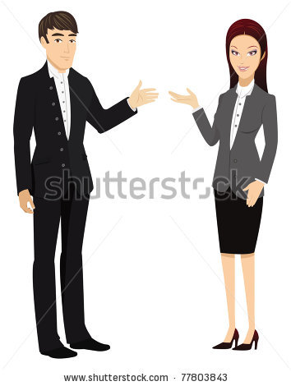
Men & Women Calories
An average man needs around 2,500 calories a day. For an average woman, that figure is around 2,000 calories a day. These values can vary depending on age and levels of physical activity, among other factors

Slide 31
8.What is known about eating disorders?
A. You can only be a women to have it
B. Severe psychological problems, such as obsessive compulsive behaviour and depression, increase the risk of developing eating disorders
C. A gram of fat contains twice as many calories as a gram of carbohydrate or protein.

Slide 32

WELL DONE
Correct.
Eating disorders

Slide 33
9.In what place is fatty food tax being discussed?
A. America
B. Ireland
C. Wales

Slide 34
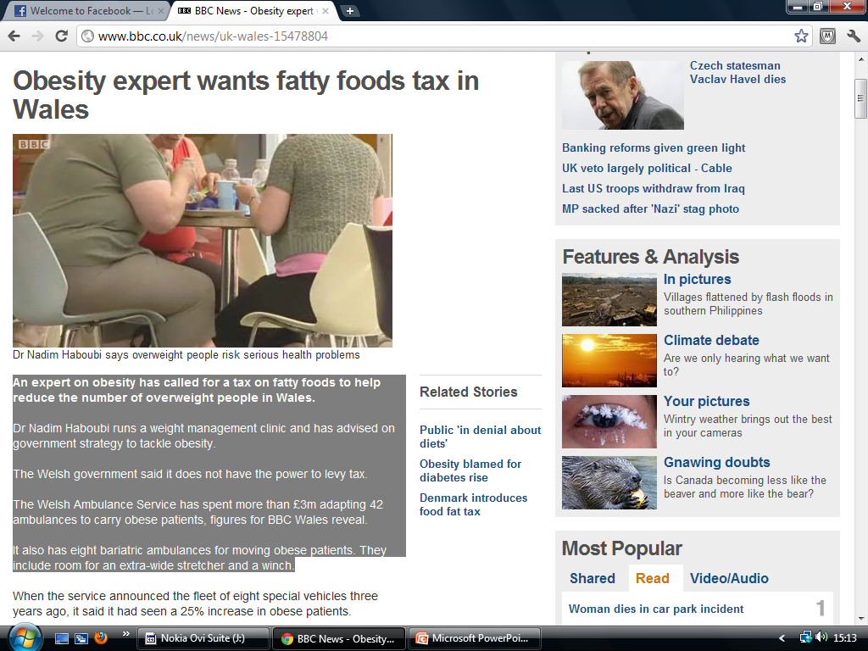
Obesity expert wants fatty foods tax in Wales
An expert on obesity has called for a tax on fatty foods to help reduce the number of overweight people in Wales.
Dr Nadim Haboubi runs a weight management clinic and has advised on government strategy to tackle obesity.
The Welsh government said it does not have the power to levy tax.
The Welsh Ambulance Service has spent more than £3m adapting 42 ambulances to carry obese patients, figures for BBC Wales reveal.
It also has eight bariatric ambulances for moving obese patients.

Slide 35
10.What does a balanced diet mean?
A. a diet that contains adequate amounts of all the necessary nutrients required for healthy growth and activity
B. to ban or omit any foods or food groups
C. Eating as much food as you like

Slide 36
Try Again
Sorry, Wrong Answer!”

Slide 37

WELL DONE
Correct.
Obesity in Wales

Slide 38

Try Again
Sorry, Wrong Answer!”

Slide 39
WELL DONE
Correct!.
Balanced Diet

Slide 40
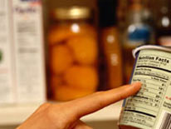
Eating Disorders
Living with an eating disorder is a miserable, lonely experience. For most people, food is one of life's pleasures and an important social event. So if your feelings about food aren't relaxed, an important part of life becomes extremely stressed.
Unfortunately, many health professionals are just as much at sea. Although eating disorders are increasing, we still know very little about their causes. Worse still, there aren't any quick or easy treatments.

Slide 41
Try Again
Sorry, Wrong Answer!”

Slide 42
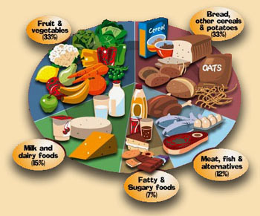
Balanced Diet
The key to a healthy balanced diet is not to ban or omit any foods or food groups but to balance what you eat by consuming a variety of foods from each food group in the right proportions for good health.
How to eat a balanced diet
Eat a variety of foods to obtain all of the essential nutrients
Too much as well as too little can be bad for you – balance is required
Everyone's plate will look slightly different as we all have different requirements depending on our body’s shape and size, and our levels of activity.

Slide 43
END OF QUIZ
Hope You enjoyed the quiz ,and hope it educated you and helped you understand health and fitness better!
If you want to learn more about health and fitness..Go to: http://www.bbc.co.uk/health/
http://www.nhs.uk/Pages/HomePage.aspx

